Slide 1
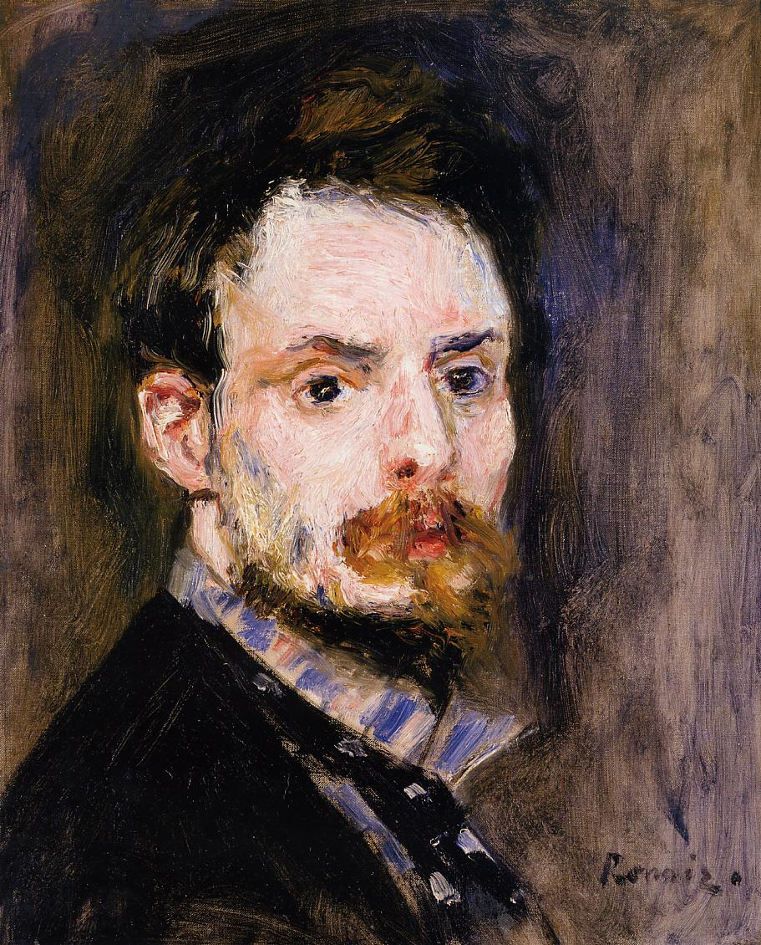
Renoir
1841 - 1919

Slide 2
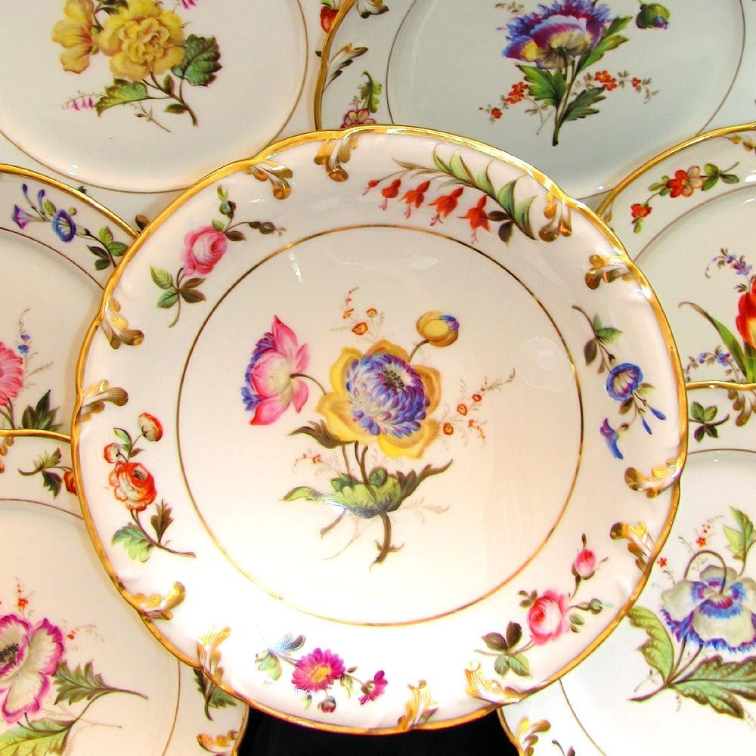
Renoir’s Background
Renoir was the only member of the Impressionists who came from a working class background.
For many years before becoming an artist he worked in a Porcelain factory; decorating the china with little flowers.

Slide 3
As a result of the closure of the factory, due to industrial developments (machines had became cheaper than manpower), Renoir forever became distrustful of new technologies.
He decided to become an artist and enrolled in the Ecoles des Beaux Arts, from where he was sent to Gleyre’s studio, where he met and befriended Claude Monet, Frederic Bazille and Alfred Sisley who were all to become prominent members of the Impressionist movement.
Video clip here

Slide 4
Renoir & the Impressionists
Together with the other Impressionists, Renoir helped develop the ‘en plein air’ technique of painting out of doors.
Popular spots to go painting were the Forest of Fountainbleu – 40 miles south of Paris and the popular middle class resort of ‘la Grenouillere’ a train ride away from Paris on the banks of the Seine near Bougival. Renoir lived here for a while with his mistress and parents who had retired to this town.
The popularity of painting ‘en plein air’ increased in the 1870’s with the introduction of paint in tubes and box or ‘field’ easels. Both the Impressionists and the Barbizon school are renowned for this method of working out of doors and not in the studio.

Slide 5
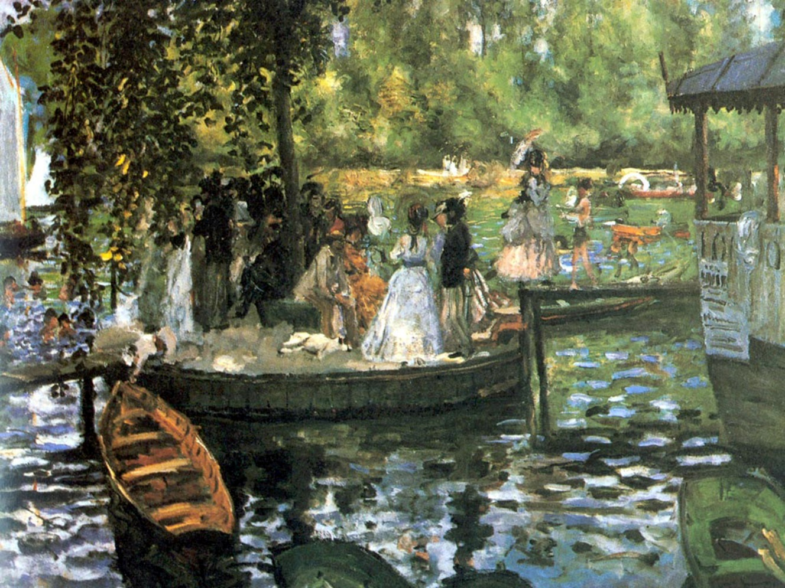
Monet ‘La Grenouille’ 1869
Renoir ‘La Grenouille’ 1869

Slide 6
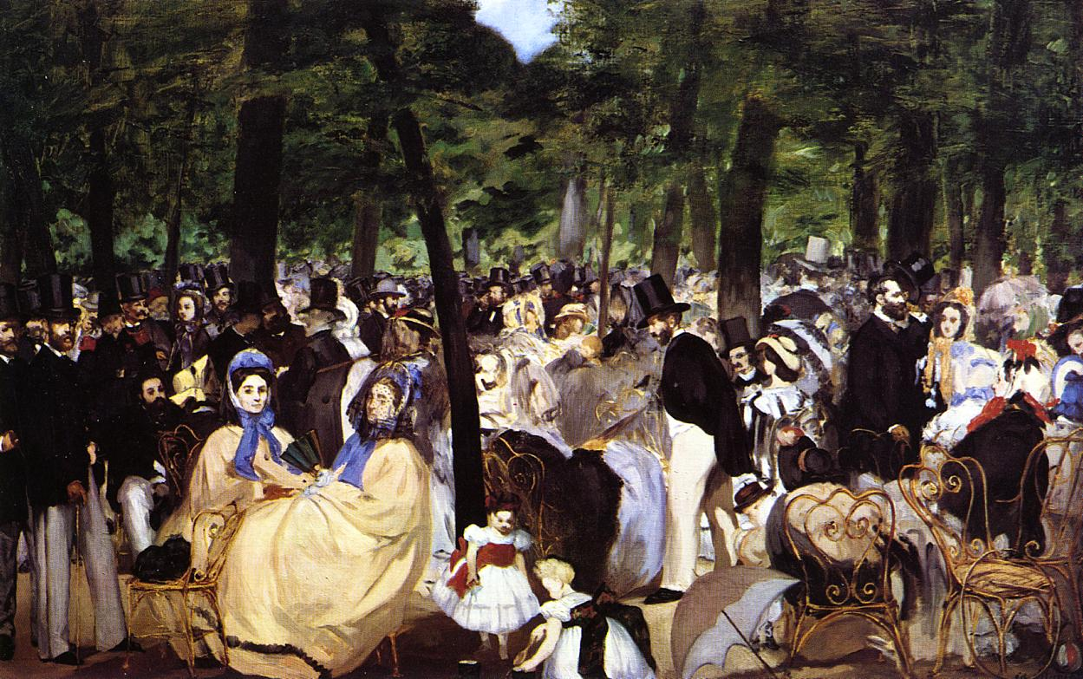
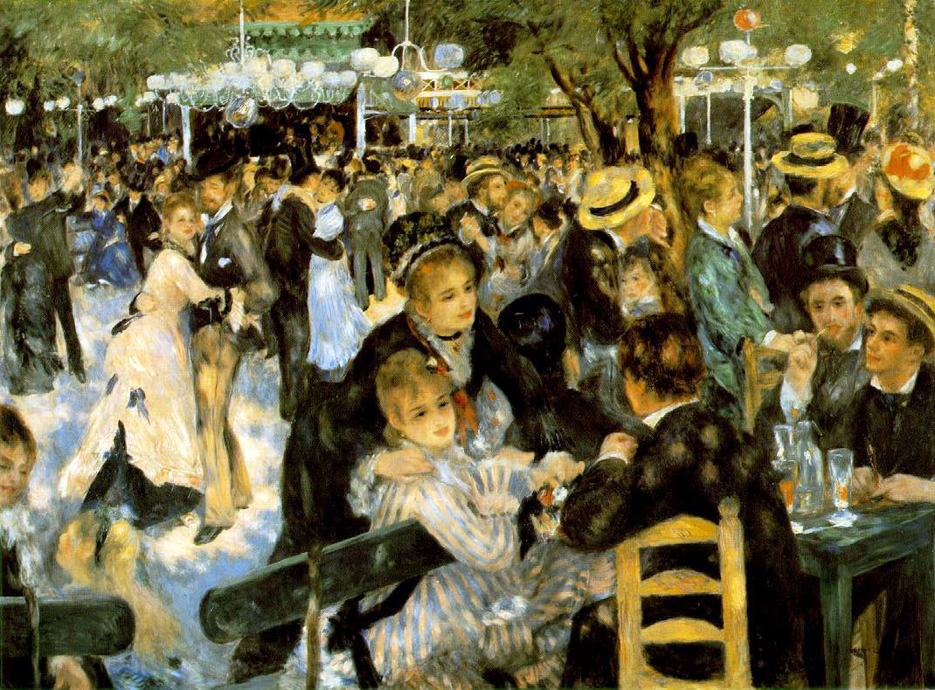
He also painting similar subjects to Manet and was influenced by his work.
Manet ‘Music in the Tuileries Gardens’ 1862
Renoir ‘The Ball at the Moulin de la Gallette’ 1876

Slide 7
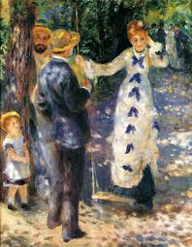
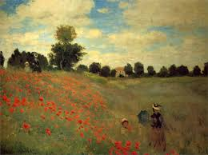
The Key Difference between Monet & Renoir in the Impressionist Phase
Monet was primarily interested in landscape and waterscapes and the way light played on this subject matter
Renoir was primarily interested in people and the way light played on them.
Monet ‘The Poppy Field’ 1873
Renoir ‘the Swing’ 1876

Slide 8
Many of Renoir’s models were either his friends or mistresses, this was initially due to his lack of money so he couldn’t afford a professional model.
Renoir had a distinctive style often painting his female models with almond shaped eyes and luxuriant hair.
He said that what he most looked for in a model was ‘an air of serenity’ and good skin that ‘took the light’.
Some of Renoir’s most successful early works are portraits and his graceful, gentle style was particularly suited to painting children.
Video clip 3min 10 – 4min 40
Tim Marlow video

Slide 10
‘The Ball at the Moulin de la Gallette’ 1876
This painting is doubtless Renoir's most important work of the mid 1870's and was shown at the Impressionist exhibition in 1877. Though some of his friends appear in the picture, Renoir's main aim was to convey the vivacious and joyful atmosphere of this popular dance garden on the Butte Montmartre. The study of the moving crowd, bathed in natural and artificial light, is handled using vibrant, brightly coloured brushstrokes. The somewhat blurred impression of the scene prompted negative reactions from contemporary critics
Video clip 7mins 45sec – 10min 29

Slide 11
Brushwork/technique
Soft, feathery strokes of pure strokes of unblended colour. An almost ‘soft focus’ effect to the painted surface.
Subject Matter
This painting describes the café/dance scene of a Sunday afternoon at the ‘Moulin de la Gallette’ in the district of Montmartre in Paris. In the late 19th century working class Parisians would dress up and spend time drinking and dancing there. It got it’s name from the ‘gallettes’ (pancakes) it served.
Colour
Light and vivid colour, no black, strong use of complementaries.
Composition
Renoir employs a diagonal composition by slicing the painting diagonally through the bottom right of the format. This is achieved by the heads of the women sitting on the bench. The scene is also ‘snapshot in composition, which gives the sense of capturing a fleeting moment of Parisian social life. Compositionally, Renior uses the dappled light passing through the trees to unite his figures with their surroundings.

Slide 12
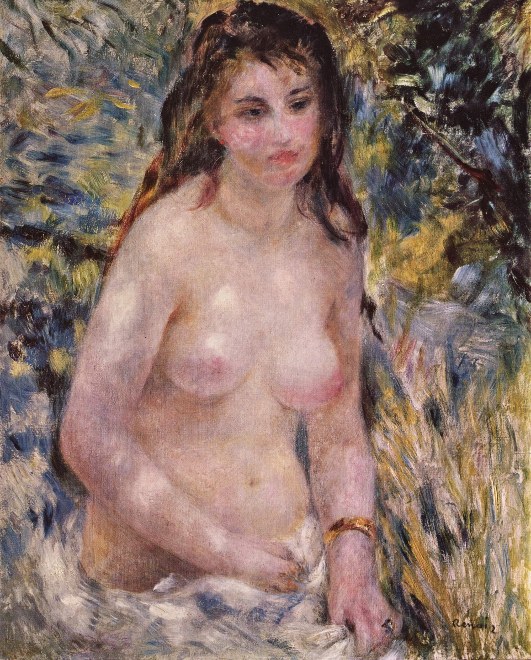
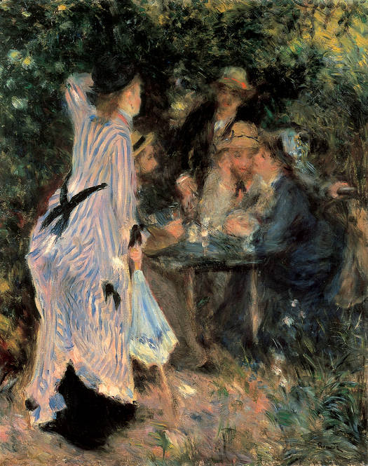
Renoir painted this work in his studio on the Rue Cortot in Montmartre in Paris. This studio had a garden which he loved to paint in also. During this time Renoir painted some of his most famous impressionist artworks, including ‘The Swing’ ‘Nude in Sunlight’ and ‘Under the Arbour’.
‘Nude in Sunlight’ 1876
‘Under the Arbour’ 1876

Slide 13
Renoir exhibited ‘The Ball at the Moulin de la Gallette’ in the 1877 Impressionist exhibition.
Although Renoir exhibited in most of the early Impressionist exhibitions, he also regularly submitted paintings into the Salon, being the first of the Impressionists to break with this new technique.
Renoir’s work was most Impressionist during the decade between 1872 and 1882.
During this time Renoir and Monet had an extremely close friendship but around 1882 both artists seemed to hit a crisis. However Monet remained true to the ideas of Impressionism but Renoir and Pissarro changed course.

Slide 14
Renoir ‘the Skiff’ 1879
Monet ‘Argenteuil’ 1874

Slide 15
Renoir loved to paint life as he saw it; slightly messy, fun and sincere, full of light full of relaxed happy people. Whether Renoir genuinely believed these joyous gatherings reflected accurately the lives of the merry makers, or whether he resolutely painted what he wanted to see is unknown. In his life he had seen the horrors of war and had lived in poverty in the slums of Paris, so maybe painting was a form of escapism for him where he could paint life as he wished to be always.
Video clip 15secs

Slide 16
Renoir’s views on Impressionism
Renoir is reported to have said of Impressionism:
“What seems to me most significant about our movement (Impressionism) is that we have freed painting from the importance of the subject. I am at liberty to paint flowers and simply call them flowers, without their needing to tell a story”.

Slide 17
Renoir’s painting ‘the Luncheon at the Boating Party’ 1880-81 is his last truly Impressionist painting.

Slide 19
‘The Luncheon at the Boating Party’ 1880-81
Subject Matter
The scene is a riverside restaurant in Paris. This was a favourite spot for boating enthusiasts and their girlfriends. It is the end of lunch and the remains of the food and drink are on the table. All appear to be enjoying themselves. The figures are all posed in a natural manner so we, the spectator feel part of the group.
Colour
This painting is warmer in palette (colour) than many of his earlier Impressionist paintings. No black is used and he still uses a lot of complementary colours to show tone.
Brushwork/technique
Although still very Impressionist in style, in this painting Renoir starts to show the change in style which is to follow. The painting is more structured and the figures are more delinated (outlined). The brushwork, though still feathery, is more defined.
Composition
Once again Renoir employs a diagonal composition, cutting across the canvas by the means of the railing of the restaurant. The composition is further linked by the interchange of glances among the members of the group. The girl in the centre leaning on the rail leads the eye to the three on the right. A relationship of some kind seems to be suggested by the artist. The woman on the right hand side is Aline Charigot, Renoir’s future wife and favourite model.

Slide 20
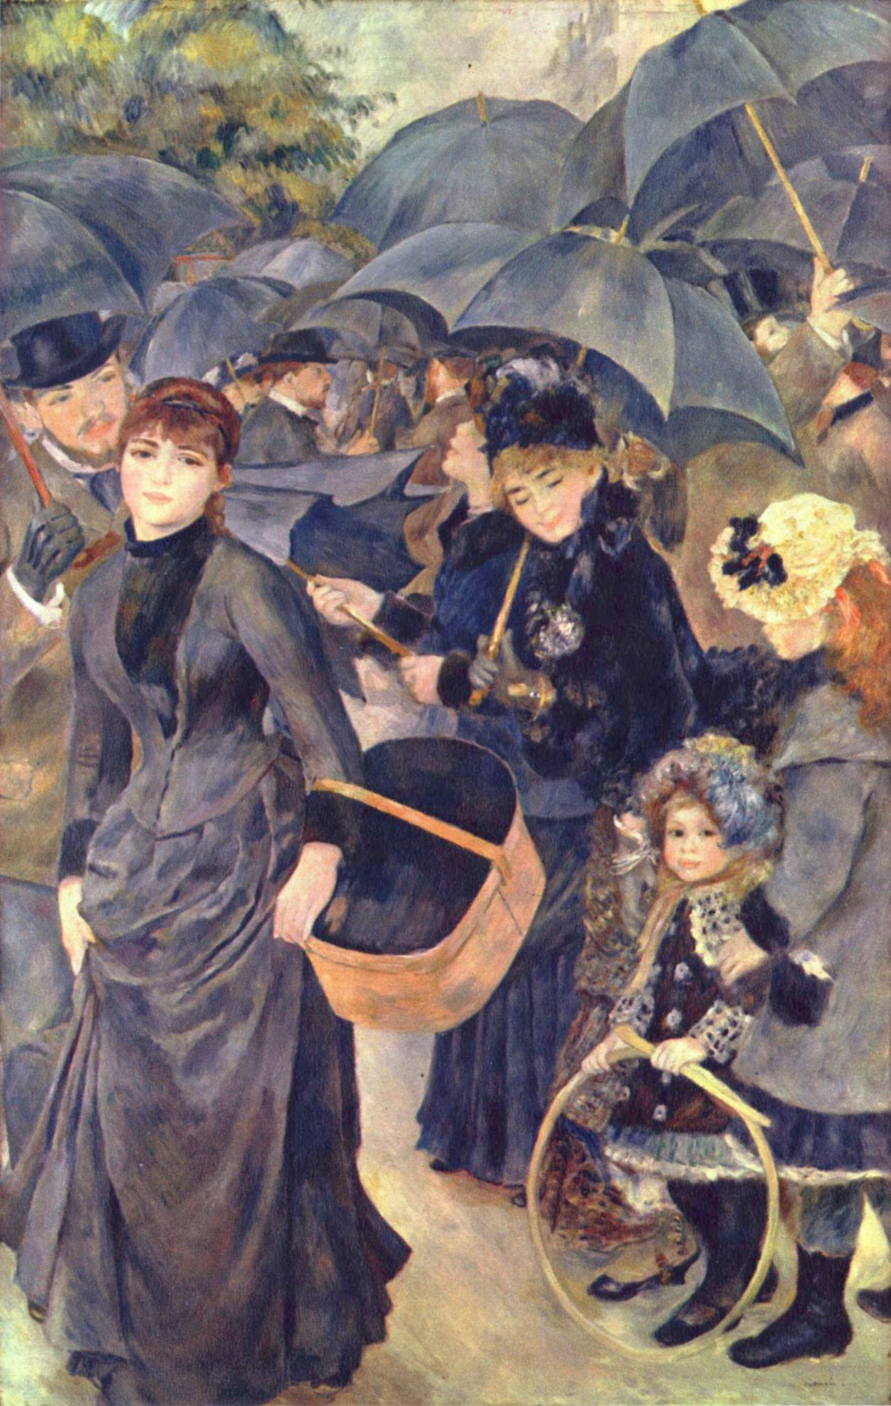
‘The Umbrellas’ 1881-5

Slide 21
‘The Umbrellas’ 1881-5
This is probably Renoir’s most famous and recognisable painting, but is the one that clearly marks the transition between two different styles, namely Renoir’s Impressionist style and his work for ‘the dry period’. The mixture of style somewhat upsets the balance of the painting. The little girls on the right are painted in a soft and feathery style such as he used in his Impressionist period, but this style is in marked contrast with the more solid forms of the other figures and above all the strong outlines of the umbrellas.

Slide 22
Composition
Strong use of snapshot composition. There is no one main focal point, instead our eyes dart from the woman with the basket to the little girls in the bottom right corner.
Subject Matter
A typical Impressionist Parisian scene, where Renoir is recording a busy street on a wet day. There is a typical Renoir-esque romanticism about the image due to the inclusion of the children and almond eyed woman.
Brushwork/technique
As this painting was completed over a large period of time, it contains two distinct styles of brushwork. The right hand side of the painting, painted in the early part of the 1880’s (1881-2) shows the feathery style Renoir had developed as an Impressionist painter. The left-hand side was painted in his ‘dry period’ and illustrates a return to a more Classical, Academic style of brushwork which can be described as smooth and sharply contoured.
Colour
This painting is almost monochromatic in it’s use of blues, but these are complemented by Renoir’s use of orange.

Slide 23
Renoir’s Dry Period
Periode Aigre

Slide 24
Renoir became one of the few Impressionist society painters, so as a result of making money from the sale of his paintings and commissions. As a result, in 1881, for the first time in his lifetime, Renoir can afford leaving Paris in spring for a trip towards the south, on the footsteps of Delacroix, first to Algeria, then to Italy, where he discovers the Florentine Masters, Raphaël and frescos of Pompéi, finally at "The Estaque", close to Marseilles, where he paints with Cézanne with more violent colours, and returns to drawing technique.

Slide 25
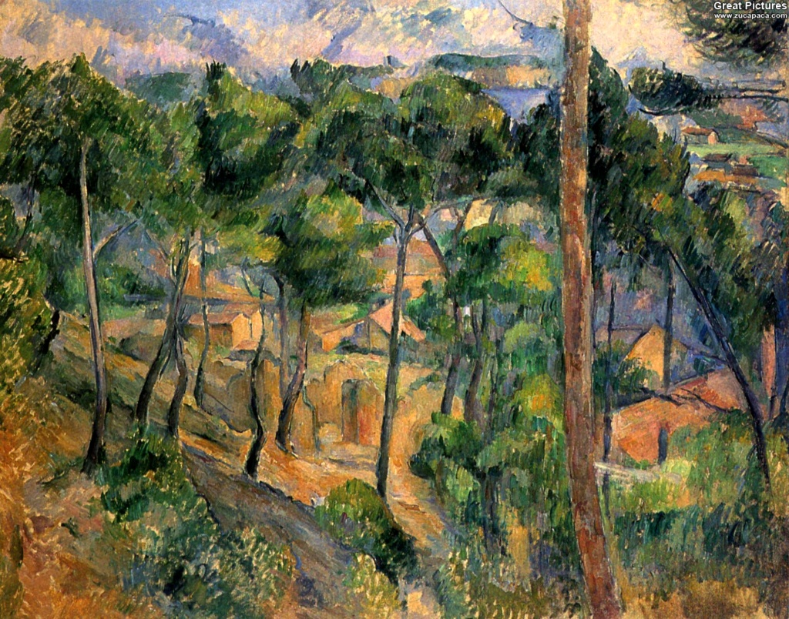
‘The Estaque’ 1882 Renoir
‘The Estaque – View through the Pines’ 1882-3
Cézanne

Slide 26
As a result of this trip, Renoir felt detached with regard to Impressionism:
"About 1883, a rupture occurred in my work. I had gone until the end of Impressionism and I arrived at this point that I did no longer master how to paint and draw. In a word, I was in a dead end“
(Renoir quoted by Vollard, in" Renoir ", Paris, 1920).

Slide 27
Renoir felt that he could not draw properly, so he went back to studying Academic painting and sculpture and the canon of paintings from the Renaissance.
From this moment, Renoir doubts and questions his work. He moves away more and more from Impressionism, contours of his characters become more precise. He draws the forms with more rigour, the colours are made colder.
In a letter to the art dealer Durand-Ruel, Renoir wrote: "I am still in the disease of research. I am not content and I erase, I still erase...."

Slide 28
Renoir’s painting ‘The Large Bathers’ shows this new style. Here he adopts the Old Master’s (Classical/Academic art) method of making detailed preparatory drawings. The result is a flat, mural-like quality to the painting.

Slide 29
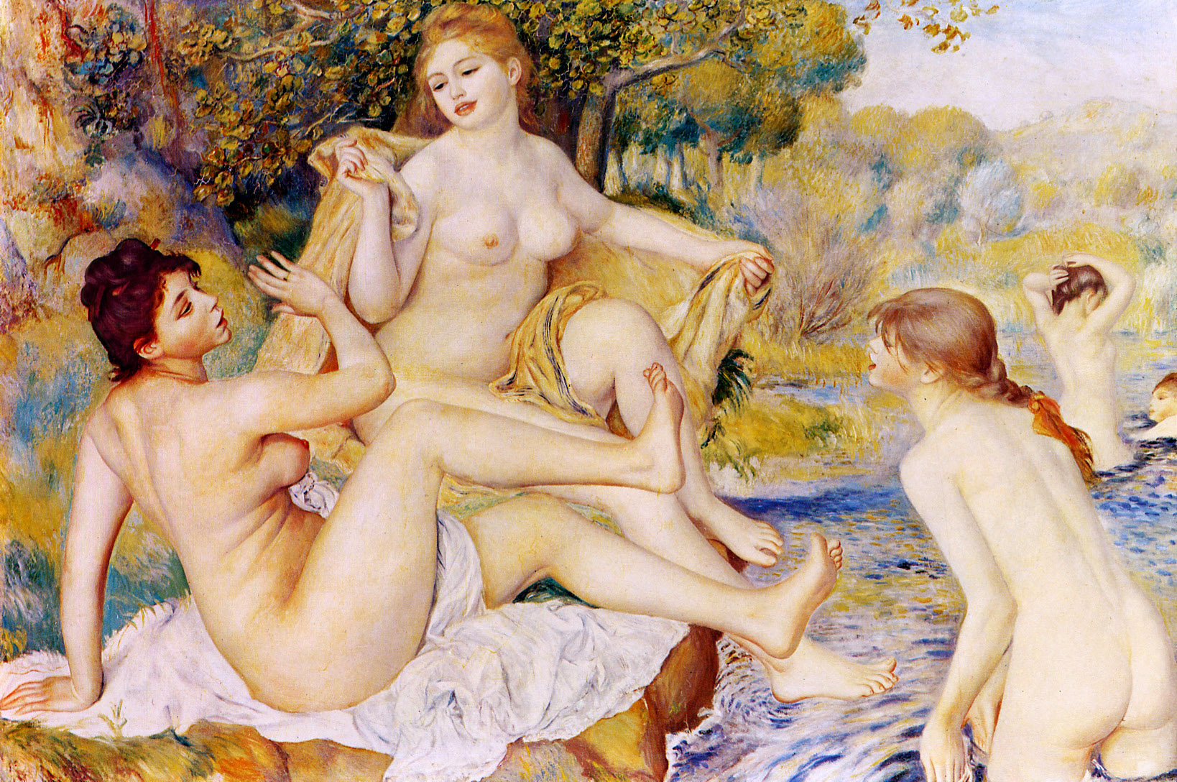
Renoir develops a new personal style of painting which is characterised by more precise drawing and more defined and smooth brushwork.
A main painting from this period is ‘The Large Bathers’ 1884-87.
The Large Bathers
1884-87

Slide 30
Subject Matter
The scene of three young nude women frolicking by the riverbank. They are idealised in style and body form
Composition
Renoir uses a classical triangular composition through the placing of the women.
Brushwork/technique
The brush work is smooth and polished and the forms are highly contoured and delineated. However there still is some use of feather brushstroke on the foliage in the background, however it is blended and smooth as opposed to any use of impasto as we would have seen in his Impressionist paintings.
Colour
Renoir uses a lighter palette and warmer colours than in his Impressionist paintings. The painting is full of light however and Renoir still uses no black.

Slide 31
By the 1890’s, the use of harsh outlines was no longer a stylistic characteristic of Renoir’s paintings, instead he returned to a style more in harmony with his instincts.
He began to use a warmer palette of colours, especially reds, as his painting became influenced by a trip to Algeria where he had been impressed by the hot sultry light.
He made many paintings of children at this time and a variety of large, sensual nudes, all glowing with radiant colour.

Slide 32
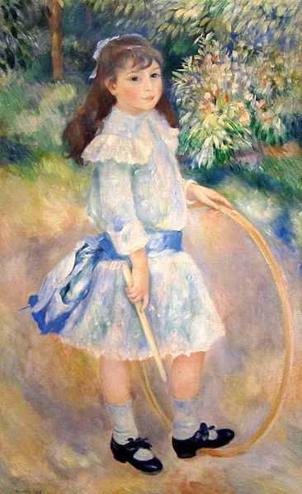
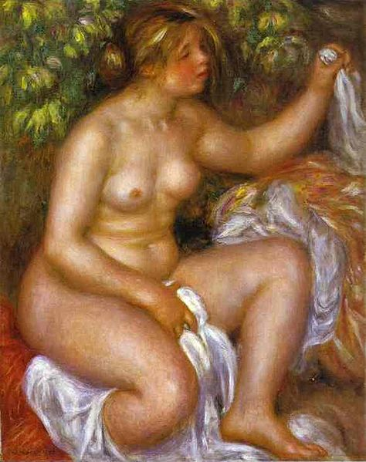
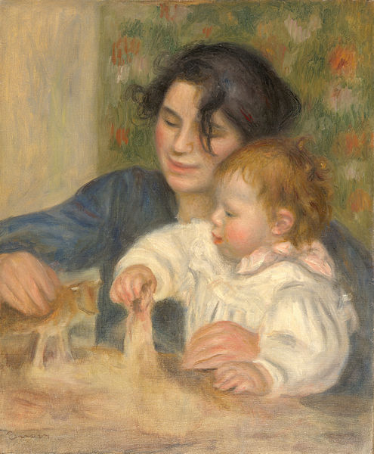
Gabrielle et Jean, 1895
After the Bath, 1910
Girl with a Hoop, 1885

Slide 33
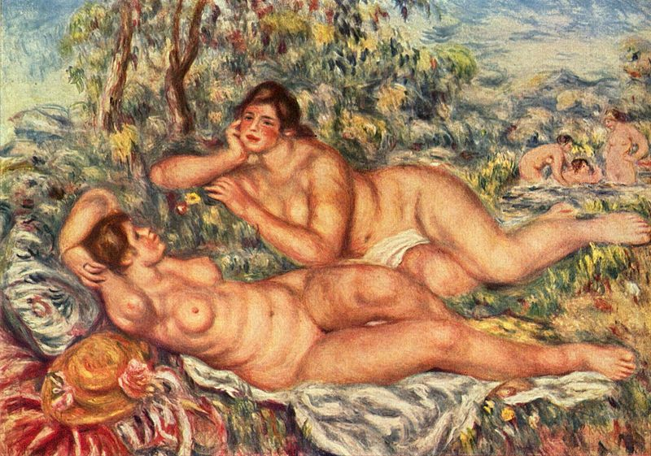
‘The Bathers’ 1918-19

Slide 34
Renoir remained obsessed with the human form, saying
“I never think that I have finished a nude, until I feel that I could pinch it”.

Slide 35
On the night he died, on December 3rd 1919, he painted a bunch of flowers and is quoted as saying:
“I think I am beginning to understand something about it”.

